Slide 1
BUILDING RELATIONSHIPS WITH
CHILDREN WHO CHALLENGE US
JOLLY TODDLERS JUNE 2021

Slide 2
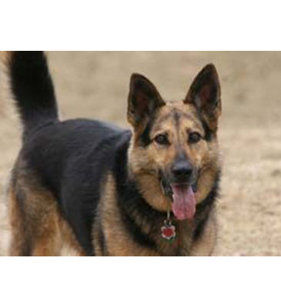
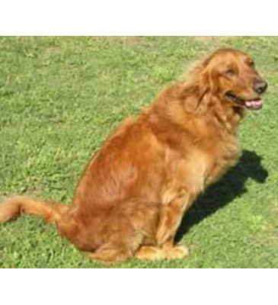
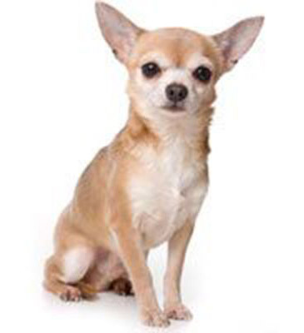
THREE DOGS EXERCISE: JOT DOWN WHAT QUALITIES COME TO MIND
GOLDEN RETRIEVER
CHIHUAHUA
GERMAN SHEPARD
Active? Noisy?
Brave? Determined?
Friendly? Gentle?

Slide 3
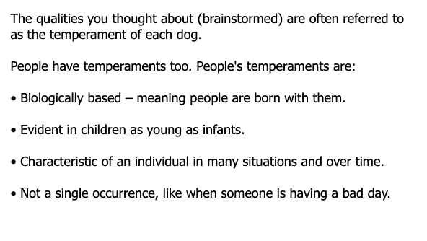
temperament

Slide 4
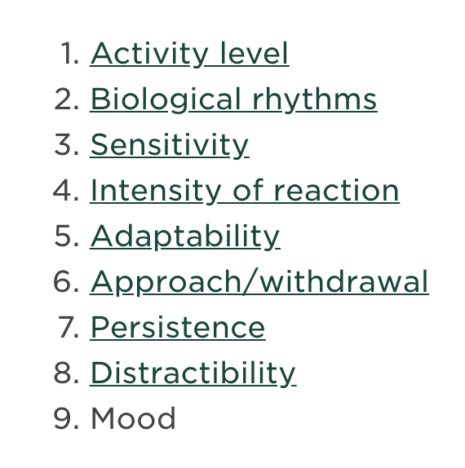
Visit this link on temperament
There are 9 different criteria. Rate Low to High. Take the attached quiz to find your temperament based on traits.
Take this Quiz: 9 types of Temperament

Slide 5
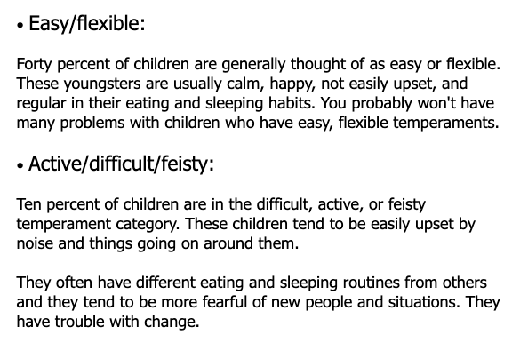
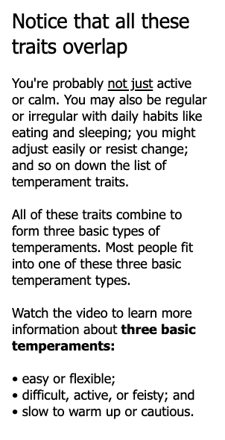
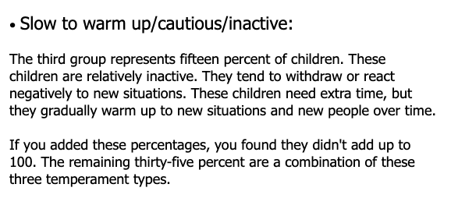
What about overlap?
WATCH THIS VIDEO:
https://youtu.be/X5WwygeREr4

Slide 6
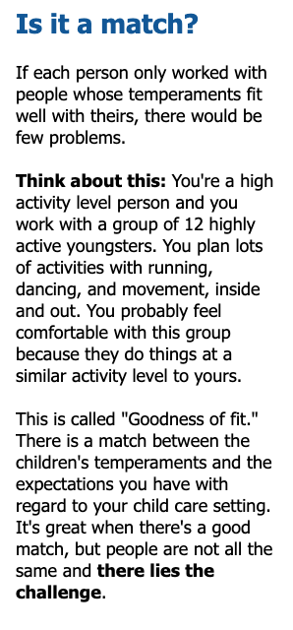
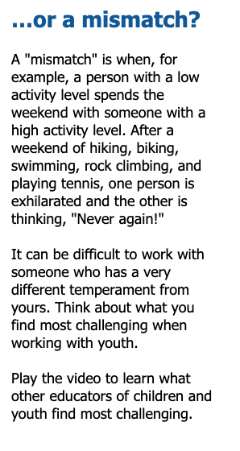
GOODNESS OF FIT
SUGGESTED VIDEOS
MATCH
https://youtu.be/p6rFQ_ix7b8
MISMATCH
https://www.youtube.com/watch?v=dFxJfLEXsx4

Slide 7
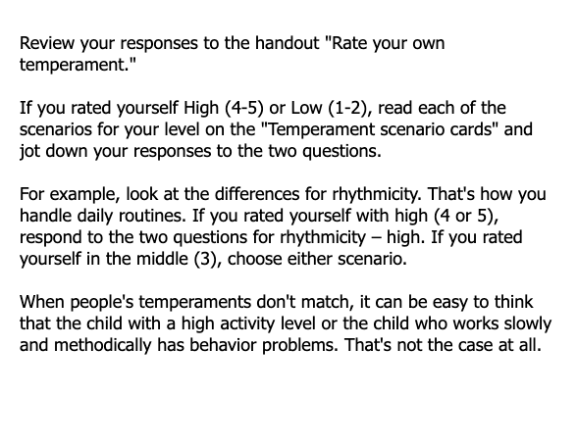
LET’S REVISIT OUR RESPONSES & USE TEMPERAMENT SCENARIO CARDS (ATTACHED)

Slide 8
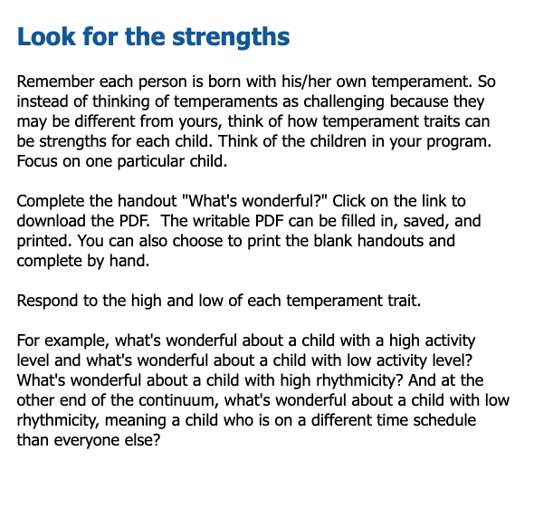
LIST 2 OR 3 STRENGTHS USING THE HANDOUT
NOW LOOK AT YOUR TEMPERAMENT QUIZ,
HOW DOES IT COMPARE?

Slide 9
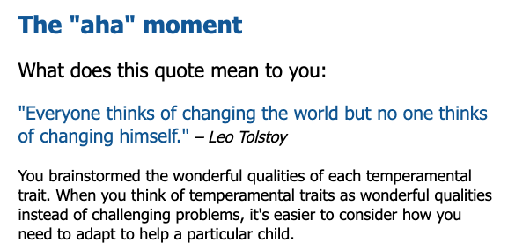
A HA MOMENT

Slide 10
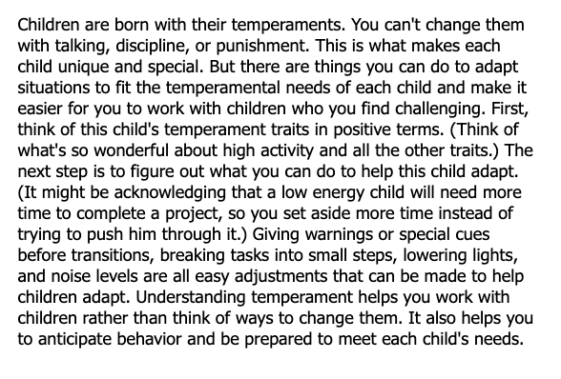
TOLSTOY CONT’D

Slide 11
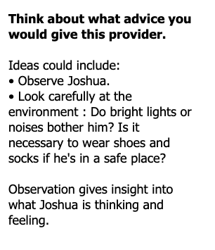
DEAR ABBY LETTER- LET’S BRAINSTORM
WATCH THIS VIDEO:
https://www.youtube.com/watch?v=aZ7mq6ekNQc&t=6s

Slide 12
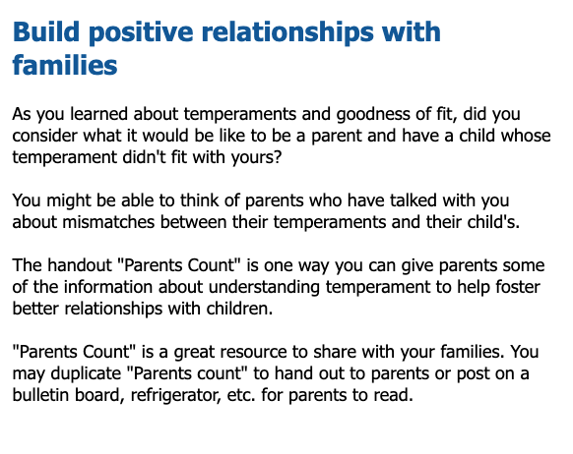
HANDOUTS: PARENTS COUNT & DID YOU KNOW?
ALSO SEE DID YOU KNOW? HANDOUT

Slide 13
Now let’s look at everyday examples
Family routine guides

Slide 20
Cooperation
How to teach

Slide 28
How to discipline
Absolutely no physical abuse. Ever.

Slide 36
Activities to avoid challenging behaviors
Handouts attached.
Notes:
We practice PBIS and Second Step, but big emotions are normal for little humans. We need to TEACH children how to behave; the same way we need to teach them anything else. Challenging behavior is only a problem when it becomes unsafe, violent, or harmful to the child or children around them (and staff). This is the kind of behavior we are talking about. If these challenging behaviors are still occurring after all these tricks have been tried, after all the BIR meetings, then it may be time to explore therapies or an IEP. There is a lot of stigma around something so helpful, but we have personal experience with them. One of us is a lawyer because of an IEP. Let’s explore later in these slides. First, How many people know about ACES?

Slide 37
What are aces?
Adverse childhood experiences are another reason why challenging behavior may be occurring.

Slide 38
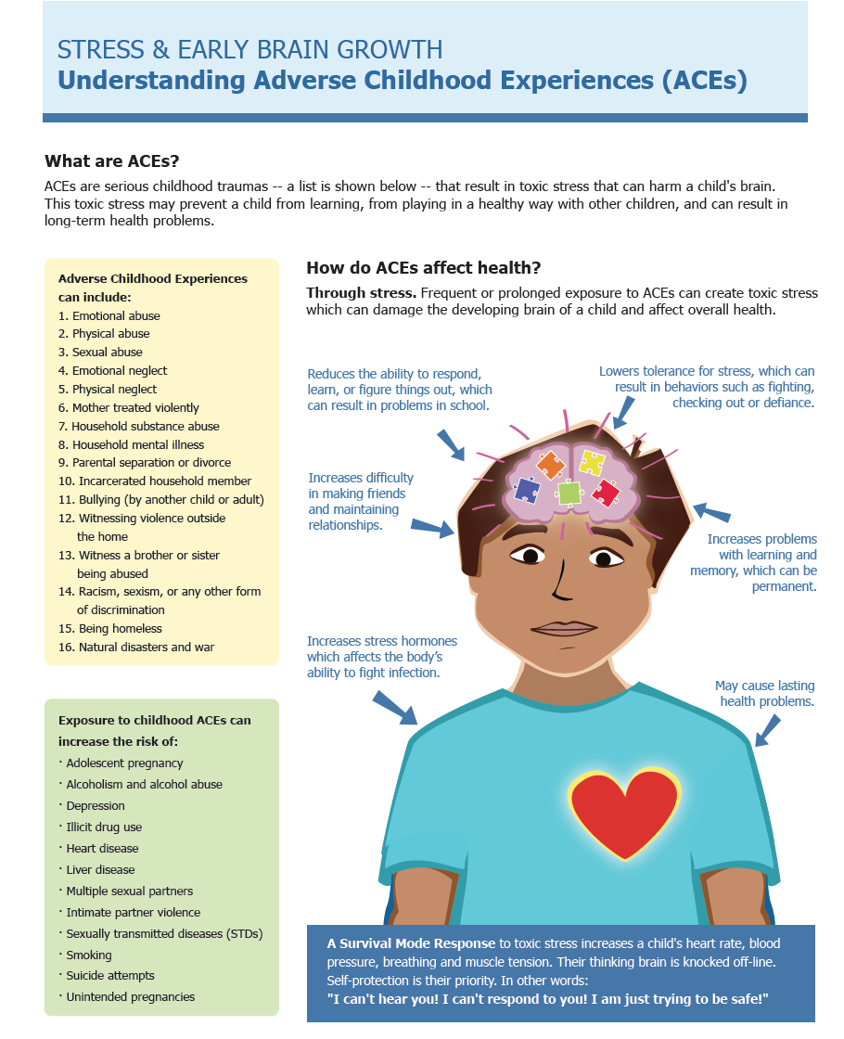

Slide 40

TED TALK BY DR. NADINE BURKE HARRIS WILL CHANGE YOUR LIFE.
THIS VIDEO WILL CHANGE YOUR LIFE.
Notes:
IF YOU DON’T WATCH ANY OTHER VIDEO TODAY, PLEASE, PLEASE JUST WATCH THIS ONE. IT WILL CHANGE YOUR LIFE. BY DR. NADINE BURKE HARRIS. https://www.ted.com/talks/nadine_burke_harris_how_childhood_trauma_affects_health_across_a_lifetime?language=en

Slide 41
What is an iep?
Individual education plan- this can be for intellectual, mental HEALTH, behavioral, or sensory challenges, etc.
And you may be entitled to accommodations, which can be life changing.
Notes:
VISIT OUR WEBSITE: https://www.jollytoddlers.com/early-intervention

Slide 45

VISIT OUR WEBSITE: https://www.jollytoddlers.com/early-intervention

Slide 46


Slide 47


Slide 49
Notes:
PLEASE TAKE OUR SURVEY BY 6-27-21

Slide 50
Notes:
PLEASE TAKE OUR SURVEY BY 6-27-21
ALL OF THESE IEP FORMS ARE AVAILABLE ON OUR WEBSITE WITH LINKS ATTACHED.

